Slide 1
VENTURE PITCH • CAMPUS TECH
Smart Campus Lost and
Found System
Centralized Digital Item Recovery Platform for University Campuses
TEAM SLEEPYGUYS
01 / 15

Slide 2
THE CHALLENGE
SC
Problem & Target Users
THE PROBLEM
Campus lost-and-found is fragmented across unofficial Telegram/Facebook groups and paper noticeboards, resulting in low recovery rates and unverified claims.
PRIMARY
SECONDARY
Students & Academic Staff
Campus Security & Office Admins
Everyday people reporting and searching for lost items on campus.
Verify claims, manage inventory, and reduce manual overhead.
02 / 15

Slide 3
RESEARCH
SC
User Discovery & Validation Evidence
CORE FINDING
78%
Users demand a single, centralized portal with instant search and filters — instead of manually scrolling through social media groups to find their belongings.
of surveyed students struggle to recover lost items during exam weeks.
03 / 15

Slide 4
OUR APPROACH
SC
Solution & Value Proposition
THE SOLUTION
VALUE PROPOSITION
• Centralized web portal for all campus lost & found activity
• Category and location-based filtering for fast search
• Status badges: Unclaimed, Pending, Claimed
• Verified claim workflow to confirm rightful ownership
< 45 sec
Reporting time reduced from minutes to seconds
Enhanced Claim Privacy
Identity verified before contact details are shared
Reduced Admin Overhead
Security staff manage claims digitally, not on paper
04 / 15

Slide 5
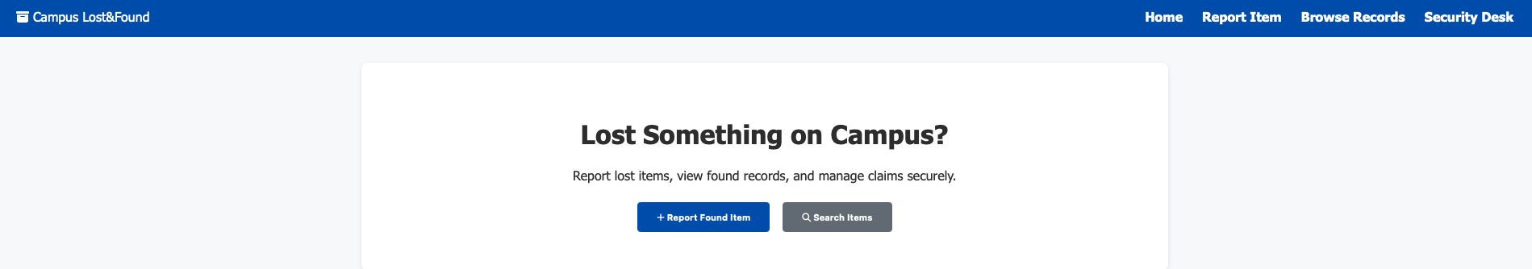
LIVE PROTOTYPE • SCREEN 1
SCREEN 1 / 5
Homepage — Landing & Entry Point
Clear campus branding and a single call-to-action get students straight into reporting or searching — no sign-up wall in the way.
05 / 15

Slide 6
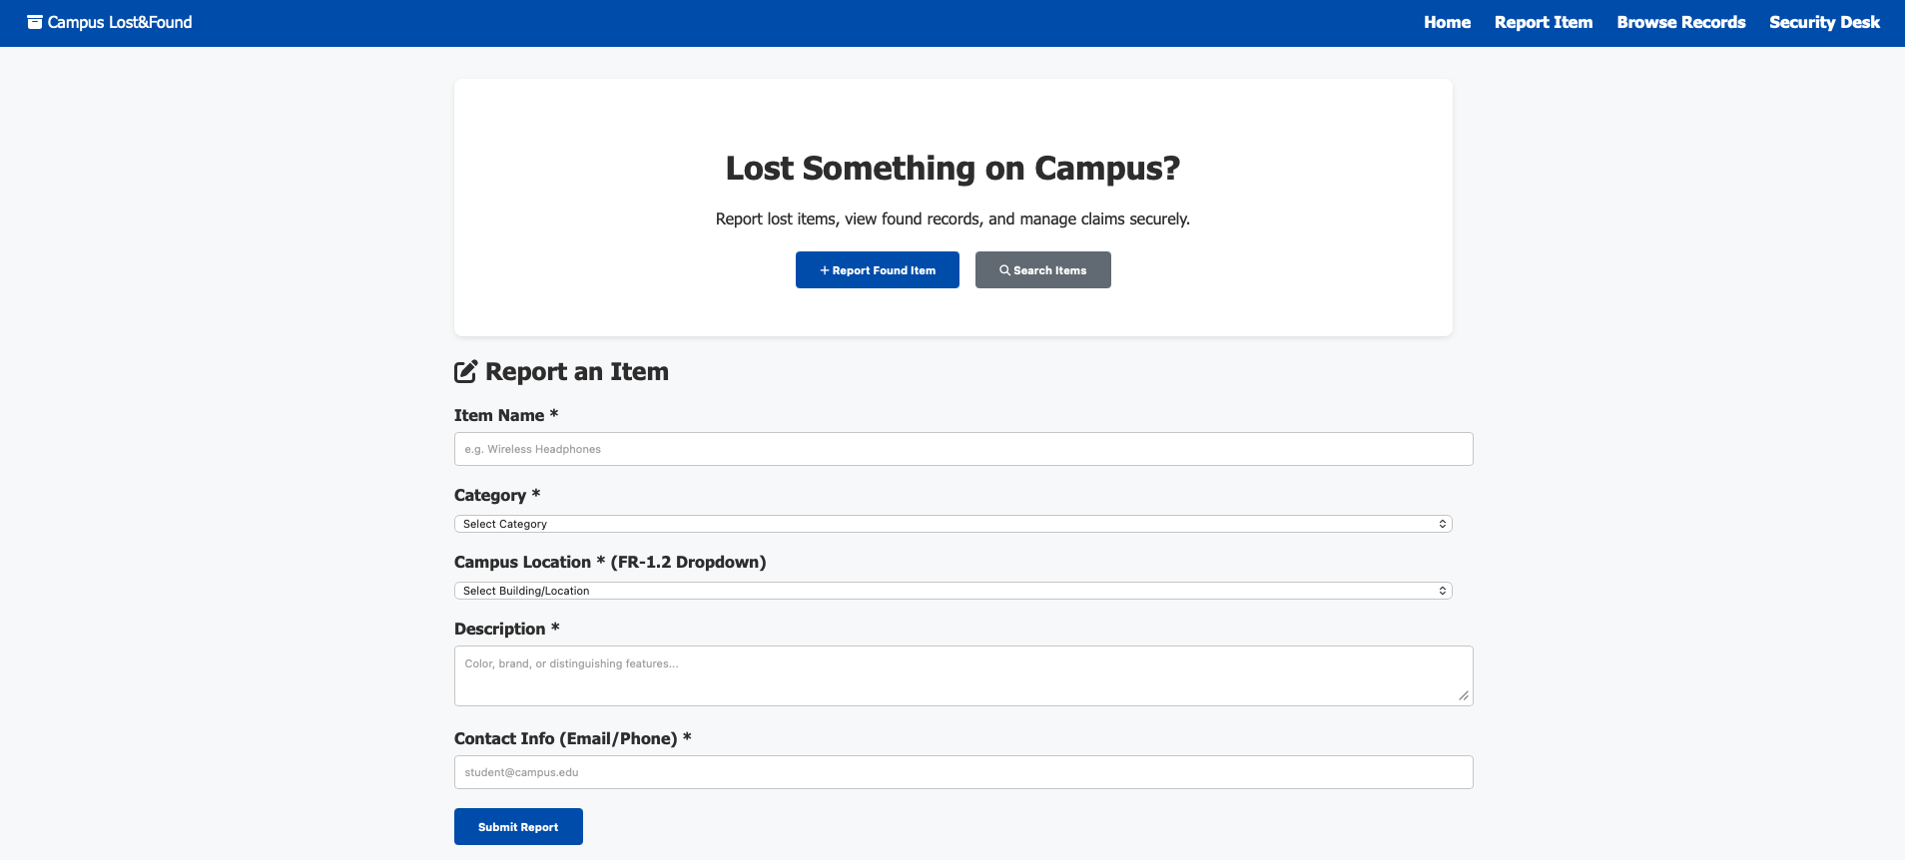
LIVE PROTOTYPE • SCREEN 2
SCREEN 2 / 5
Report an Item — Structured Submission Form
Category and Campus Location dropdowns (FR-1.2) constrain input to valid, searchable values instead of free-text guesswork.
06 / 15

Slide 7
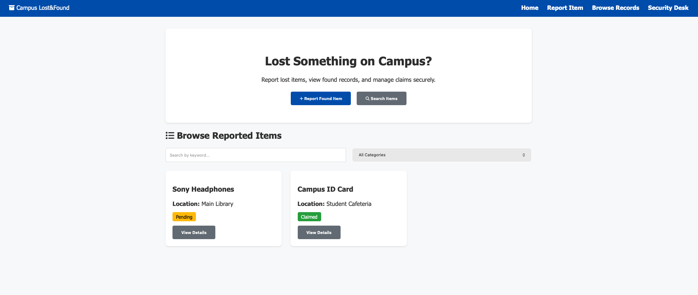
LIVE PROTOTYPE • SCREEN 3
SCREEN 3 / 5
Browse Reported Items — Search & Filter
Keyword search plus category filtering replace endless social-media scrolling with instant, structured results.
07 / 15

Slide 8
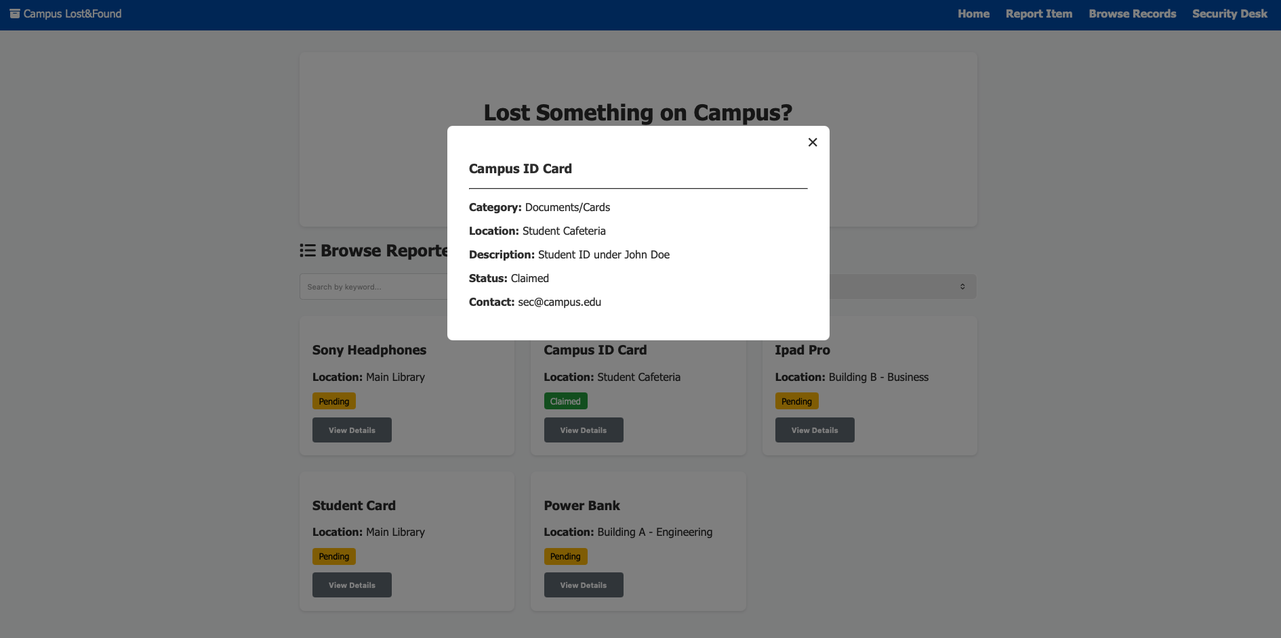
LIVE PROTOTYPE • SCREEN 4
SCREEN 4 / 5
Item Detail View — Verified Claim Path
A focused detail modal surfaces category, location, description, and status — the entry point into the verified claim workflow.
08 / 15

Slide 9
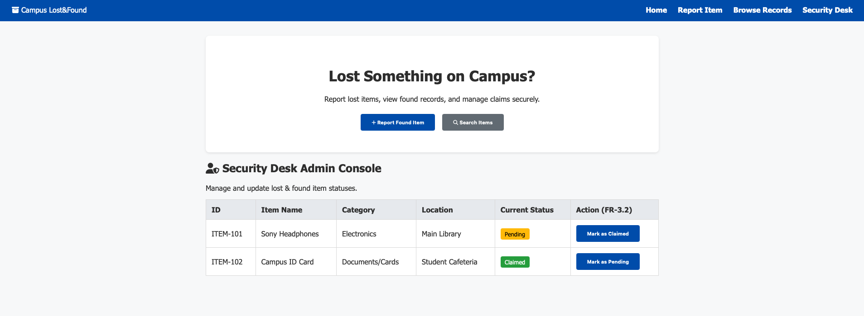
LIVE PROTOTYPE • SCREEN 5
SCREEN 5 / 5
Security Desk Admin Console
Campus security updates claim status (FR-3.2) in one click — replacing manual paper logs with a real-time, auditable record.
09 / 15

Slide 10
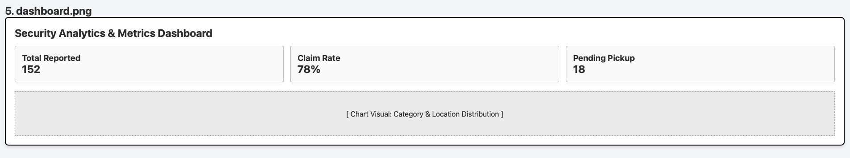
COMING NEXT • IN DESIGN
SC
Security Analytics Dashboard (Wireframe)
Early wireframe for campus-wide recovery metrics — total reports, claim rate, and pending pickups — planned for the next build phase.
10 / 15

Slide 11
STRATEGY
SC
Business Model & Go-To-Market
BUSINESS MODEL
GO-TO-MARKET
B2B Campus SaaS Model
Orientation Week Rollout
Annual enterprise subscription license billed directly to university administration — predictable, recurring revenue tied to each campus deployment.
Strategic QR code posters placed in high-traffic campus zones during Orientation Weeks, driving early adoption from incoming students.
11 / 15

Slide 12
TRACTION
SC
Product & Startup Metrics
82%
< 45 sec
Successful Item Recovery Rate
during prototype user testing
Average Time to Report a
Lost or Found Item
12 / 15

Slide 13
UNDER THE HOOD
SC
Technical Architecture & Data Handling
TECH STACK
DATA HANDLING
HTML5
Simulated persistent storage using the browser's LocalStorage layer, enabling real-time Create, Read, Update, and Delete (CRUD) operations for the prototype without a backend server.
CSS3 (Flexbox / Grid)
Modern ES6 JavaScript
13 / 15

Slide 14
WHAT'S NEXT
SC
Future Roadmap & Technical Enhancements
PHASE 1
PHASE 2
AI-Based Image Matching
Campus SSO Integration
Automatically compare photos of reported lost items against the found-items database to surface likely matches instantly.
Single Sign-On with university student credentials to verify ownership and streamline authenticated access to the portal.
14 / 15

Slide 15
THANK YOU
Closing & Discussion
Turning lost items into quick campus recoveries.
Thank You! Open for Questions & Discussion.
TEAM SLEEPYGUYS
15 / 15

